Slide 1

Classic Cryptography
By: Matias Carhuamaca
CS 131 Spring 2022
05/22/22

Slide 2
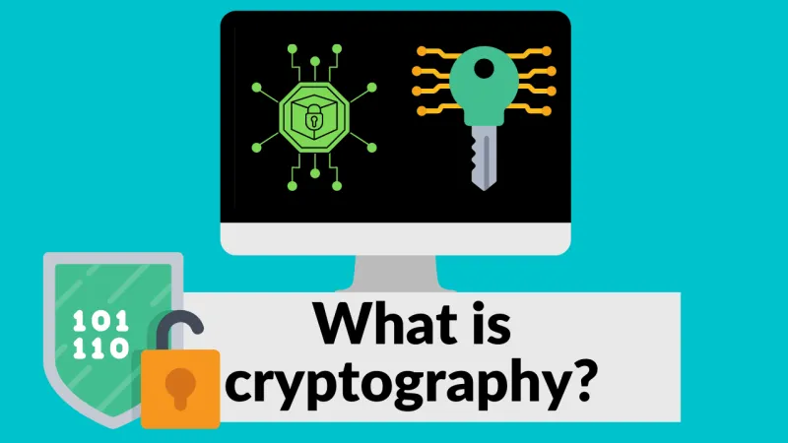
What is Cryptography?
Practice and study of techniques for safe and secure communication between two parties
Construction and analysis of protocols used to make certain private information and messages not easily obtained
Modern-day, it is the most common form of cybersecurity

Slide 3
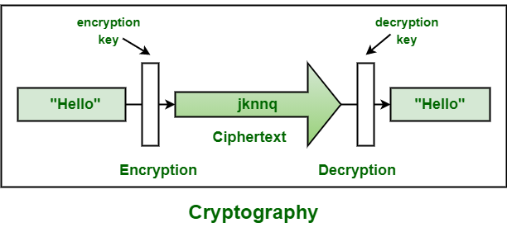
Uses of Cryptography
To prevent access and invasion of privacy of sensitive information by third party adversaries
Used in Emails, company devices, electronic payments, websites, etc.
All big and major companies and government agencies utilize cryptography to have secure communications and keep sensitive information confidential

Slide 4
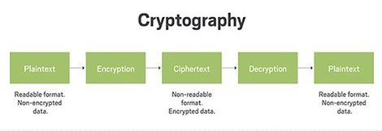
How is Cryptography Done?
Done through the process of encryption and decryption using a set key; This key is known as a cipher and it is an established algorithm for which the encrypted content can be decrypted
Earliest recorded use of cryptography was Caesar Cipher in the 9th Century
Classical Cryptography, such as the Caesar Cipher, rely on the concept of shift cipher for their encryptions and reverting the process in order to decrypt

Slide 5
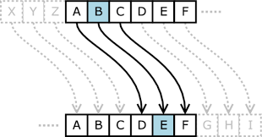
Shift Ciphers
Follow formula f (p) = (p + k) mod 26;
p being the numerical value relative to the original letter’s location in the alphabet, and k being the shift amount
Since there are only 26 letters in the alphabet, the mod 26 is there to reset count so that the value is always valid
Caesar Cipher is shift cipher of three so k = 3. So message letter A -> D
“Hello There” -> “Khoor Wkhuh”

Slide 6
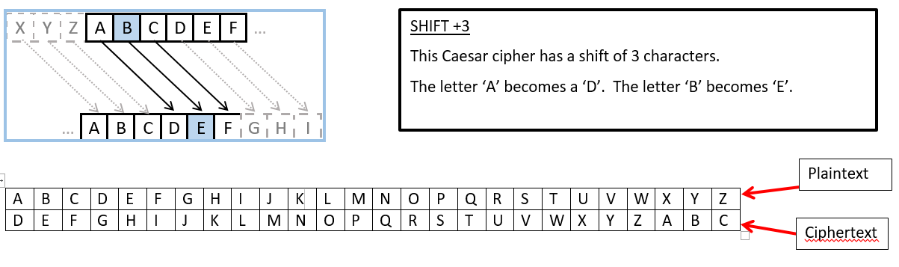
Encryption
As previously mentioned, classical cryptography uses the function f(p) = (p + k) mod 26
k is assigned specific value and it is set as the key between the two parties
All letters are then shifted by the provided k value to finalize the cipher
Cipher is sent sent to the second party which already has the key

Slide 7
Decryption
In order to decrypt, the second party uses the key (established k value) to reverse the shift of the letter
Better understood as the function f^ −1(p) = (p - k) mod 26
Moving back the letter given in the cipher by the value k that corresponds to the alphabet retrieves the original messages
D -> A; so “Khoor Wkhuh” -> “Hello There”

Slide 8
Cryptanalysis
Process of recovering /decrypting ciphertext without knowledge of both the encryption method nor the key
Possible with classical cryptography due to its lower complexity but still complicated to achieve
Trial and error method of replacing most common found letter in the cipher with the most common found letter in english lexicon and attempting to make sense of result.
If result makes no sense, then move on to replacing the most common letter in the cipher with the second most common letter in english
lexicon and so on.

Slide 9
Example of Cryptanalysis
Decrypt “Hthgpun”
The nine most common letters in English text and their approximate relative frequencies are E 13%,T 9%, A 8%, O 8%, I 7%, N 7%, S 7%, H 6%, and R 6%
-Most common letter in the cipher is “H/h”, therefore replace all H/h with E. E -> H is a shift of 3 so shift all other letters back by 3 resulting in “Eqedmrk”. Makes no sense so move on.
-Replace H/h with T. T -> H is a shift of 14 so shift all other letters forward by 14 resulting in “Tftsbgz”. Still makes no sense so move on.
-Replace H/h with A. A -> H is a shift of 7 so shift all other letters back by 7 resulting in “Amazing” which makes sense. Therefore, the message was “Amazing” with the key being
k = 7.

Slide 10
Block Ciphers
More complex form of cryptography
Instead of changing individual letters/characters with other individual characters, this cipher is done by replacing blocks of letters with other blocks of letters
Uses permutations and by splitting the letters into blocks of certain size
Ex: Encrypt “PIRATE ATTACK”
We first split the letters of the plaintext into blocks of four letters.We obtain PIRA
TEAT TACK. To encrypt each block, we send the first letter to the third position, the second
letter to the first position, the third letter to the fourth position, and the fourth letter to the second
position. We obtain IAPR ETTA AKTC

Slide 11
Works Cited
“Cryptography.” Wikipedia, Wikimedia Foundation, 20 May 2022, https://en.wikipedia.org/wiki/Cryptography.
Google Images, Google, https://images.google.com/.
Rosen, Kenneth H. “4.6 Cryptography.” Discrete Mathematics and Its Applications, McGraw-Hill, New York, 2019.
“What Is Cryptography and How Does It Work?” Synopsys, https://www.synopsys.com/glossary/what-is-cryptography.html.

Slide 12
The End
Thank you for your time!

